Slide 1
Introduction to Deep Learning
Artificial Intelligent and Machine Learning Class
Rizka Wakhidatus Sholikah

Slide 2
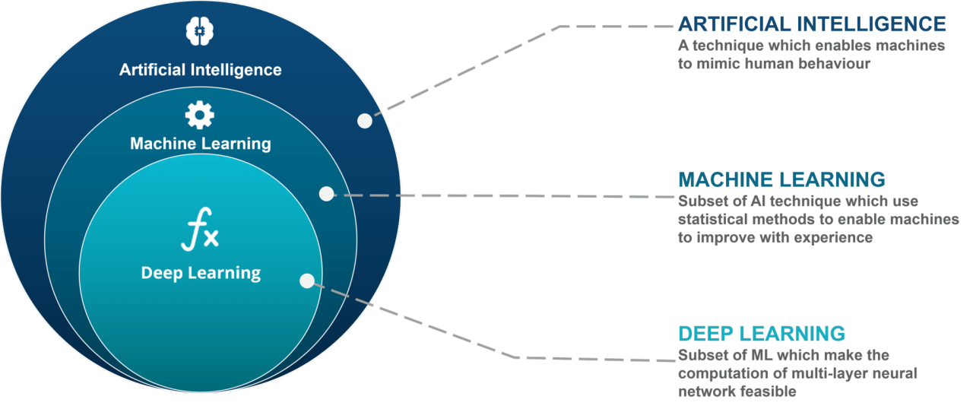
What is DL?
Deep Learning (DL) is a subset of machine learning driven by multilayered neural networks whose design is inspired by the structure of the human brain - IBM

Slide 3
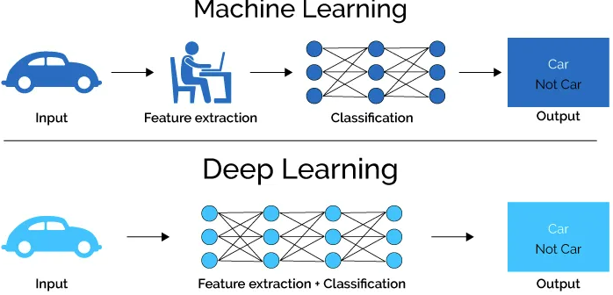
ML vs DL
Machine learning need hand crafted features while deep learning extract features automatically during training.

Slide 4
When to use ML or DL?
Machine Learning when:
The dataset is small
The problem is structured → tabular
Need easy interpretability
Deep Learning when:
The dataset is large
The data is unstructured and complex

Slide 5
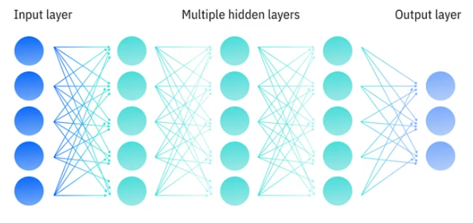
How does DL work?
DL works by using layered of neural network to perform prediction → error → correction It is repeated until find the suitable model.
DL learn the features and learn to create the model from them.
In DL we can feed raw data such as Image, Text, Audio.
https://www.ibm.com/think/topics/deep-learning

Slide 6
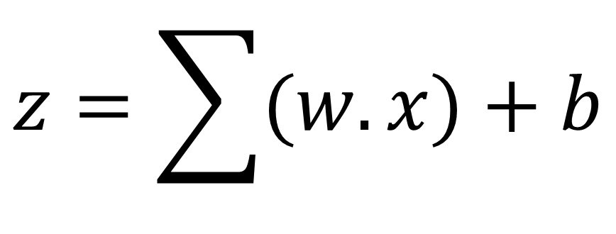
Deep Learning Layers
Input Layer:
Receive the data as an input and passes it into the network
No learning
Number of neurons == number of input dimensions
Example:
Image RGB with size 64x64 need 64x64x3 = 12.288 neurons
Hidden Layer
Layer that processes and transform data to learn patterns
Each neuron perform the multiplication as shown in equation bellow
$$z=\sum{(w.x)}+b$$

Slide 7
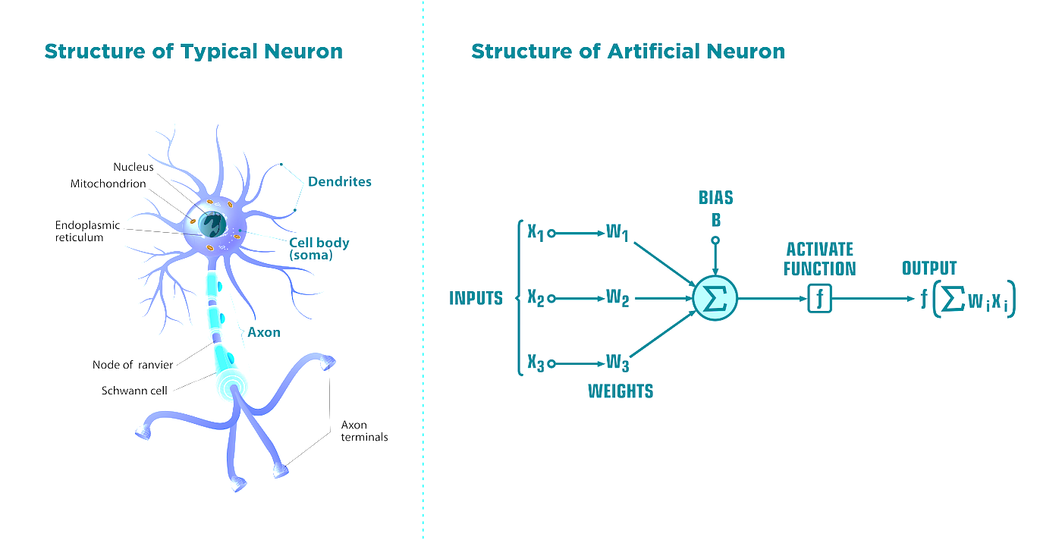
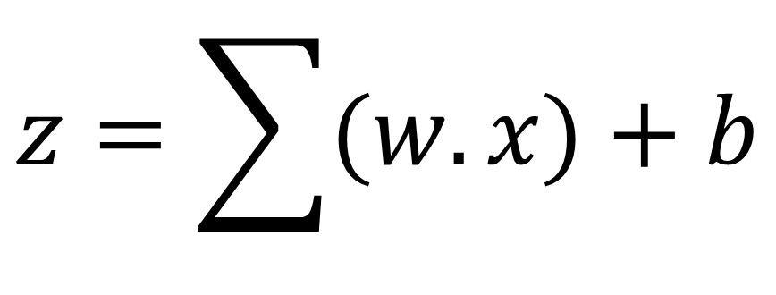
Deep Learning Layers
$$z=\sum{(w.x)}+b$$

Slide 8


Deep Learning Layers
Hidden Layer:
Inside the hidden layer we use activation function to make the model capture more complex pattern.
Example activation function:
ReLU (Rectified Linear Unit)
Sigmoid
Softmax
Tanh
$$z=\sum{(w.x)}+b$$
$$h=f(z)$$

Slide 9
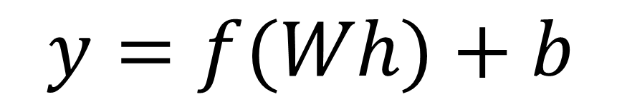
Deep Learning Layers
Output Layer:
The final layer of a neural network.
Decide the result from the pattern that learn by hidden layers.
The number of neuron in the output layer depend on the number of label to predict.
$$y=f(Wh)+b$$

Slide 10
MLP mechanism
MLP (Multilayer Perceptron)
The very simple architecture of deep learning that only contain input layer, hidden layer, and output layer
Mechanism Forward pass → Loss → Backpropagation → Parameter update
Forward Pass
Make a prediction
Data flow from input until output layer
Loss
Calculate the error in the output layer compared to ground truth
Using certain loss function (e.g. cross-entropy)
Backpropagation
Compute gradients
Error flow from output back through layers
Update parameter in the direction reduce error

Slide 11
CNN
CNN (Convolutional Neural Network)
CNN is a type of DL architecture that suitable to process grid-like data (e.g. Images)
The common task that suitable with CNN
Image classification
Object detection
Face recognition
Why not using MLP??
The input is very large → has too many parameters
No understanding of spatial structure (each pixel is processed individually)

Slide 12
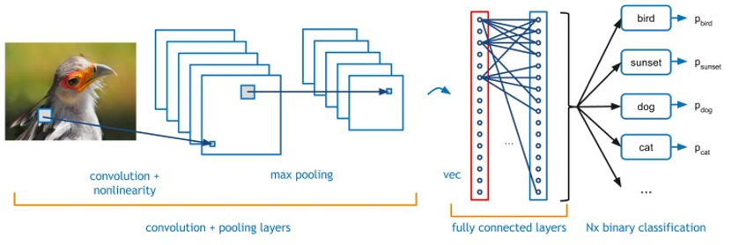
CNN
Main component of CNN
Convolutional Layer
Feature Maps
Activation Function
Pooling Layer
Fully Connected Layer

Slide 13
Convolutional Layer
Convolutional Layer
Convolutional layer is used to extract meaningful features from data
Example:
Edges
Corners
Textures
Shapes
How does convolutional layer works?
A convolutional layer applies small learnable filters (kernels)
The kernel usually consist of small window (3x3)
The kernel are sliding across the image and compute a value at each position.

Slide 14
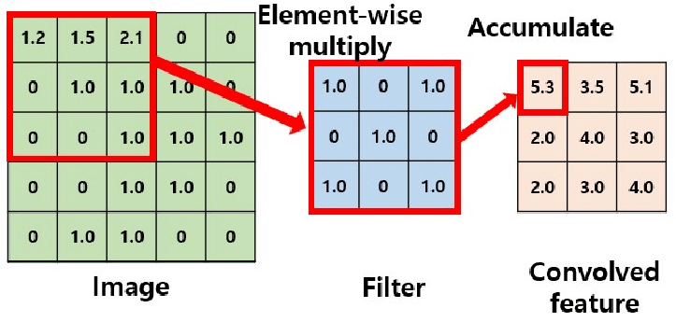
Convolutional Layer
Element-wise multiplication + summation
https://medium.com/@pranjalkhadka/understanding-convolutional-neural-network-cnns-e6f6e58fe249

Slide 15
Convolutional Layer
Components of Convolutional Layer
Kernel (Filter)
Use to extract features from input
Small matrix (e.g. 3x3, 5x5)
Stride
How far the filter moves each step
Larger stride means smaller output
Padding
Adding zeros around the image
Feature Map (Output)
Result of applying one filter

Slide 16
Feature Map
Feature map is the output of a convolutional layer after applying a filter (kernel)
The feature maps
Preserve spatial information
Highlight important regions
Reduce raw complexity

Slide 17
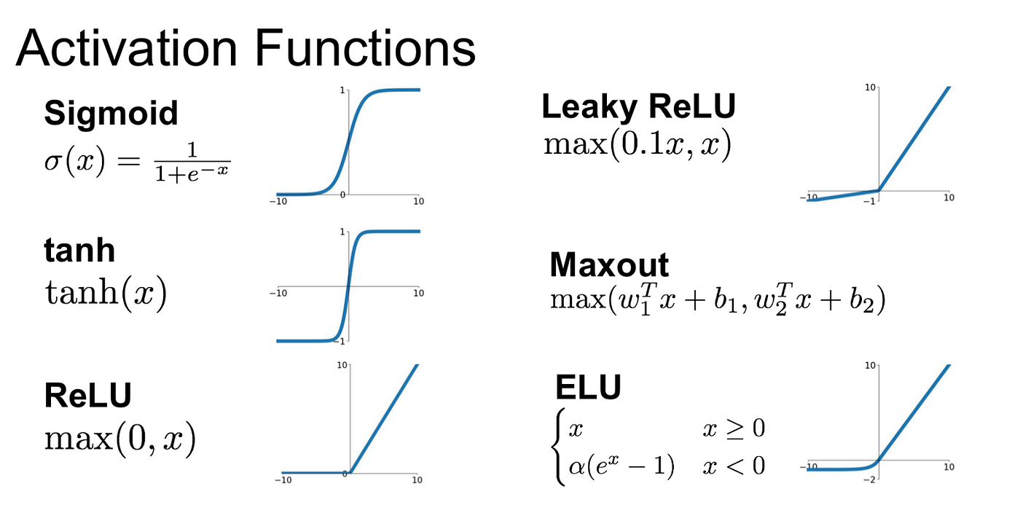
Activation Function
Activation function is use to decide how strong the neuron should pass information forward.
The activation function makes neural networks non-linear
Best practice: ReLU is used in hidden layer

Slide 18
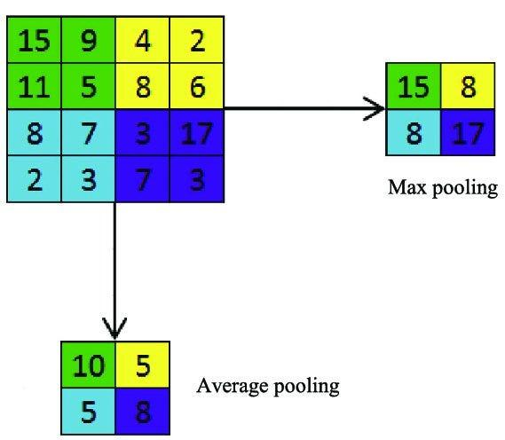
Pooling layer
Pooling layer is a down sampling operation of the feature map.
It used to reduce spatial size of feature map
Type of pooling:
Max pooling → strongest feature
Average pooling → overall info
Min pooling → weakest feature

Slide 19
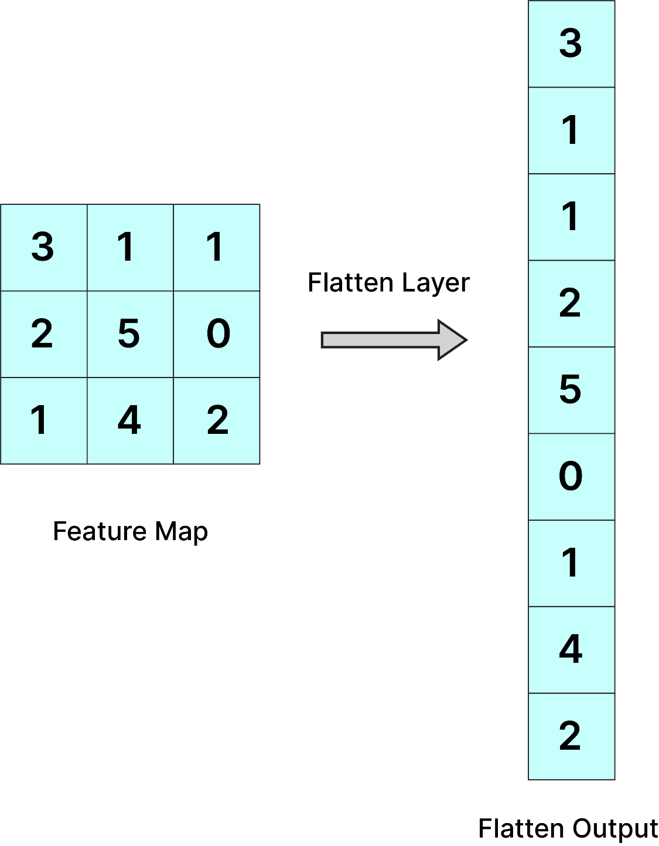
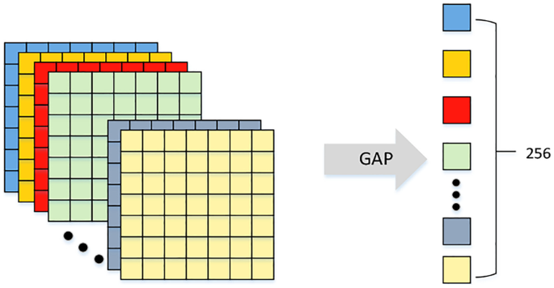
Fully connected layer
Fully connected layer also called as dense layer
Every neuron is connected to all neurons from the previous layer
The expected input of fully connected layer is 1D vector
But the output from feature layer is 3D, the solution
Flatten layer
GAP (Global Average Pooling)

